Slide 1
A Novel Generalization between Verbal Judgments and Perceptual Discrimination of 3D Space
Prachi Mahableshwarkar
The George Washington University

Slide 2


Image Complexity

Slide 3
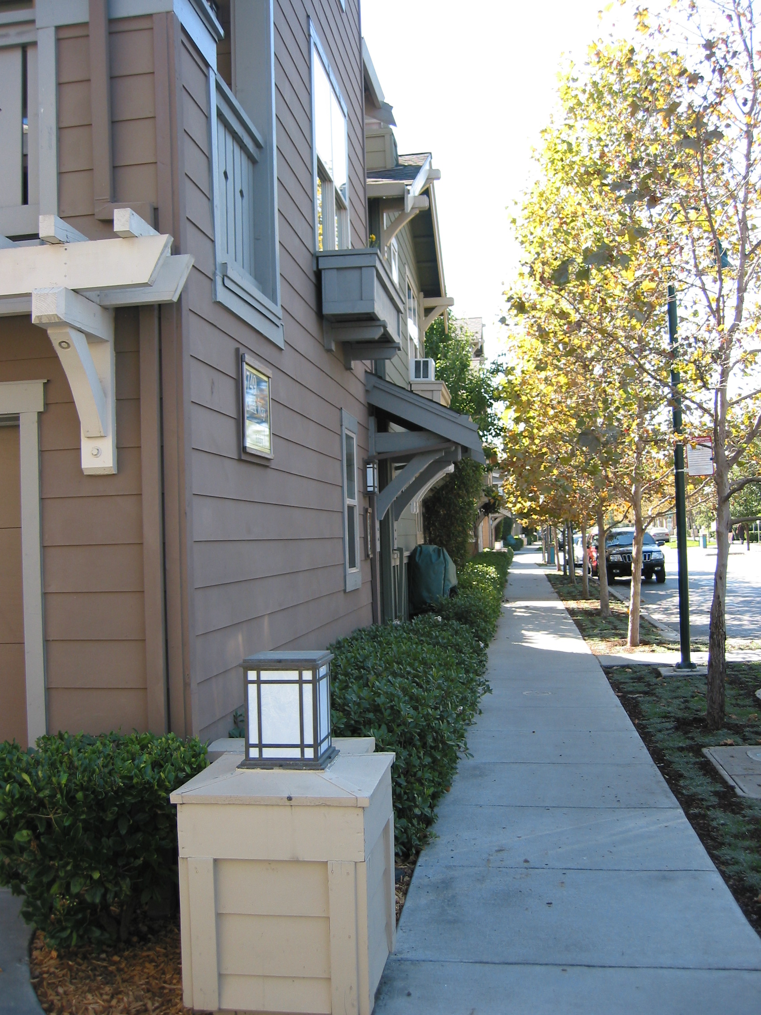
What cues facilitate depth perception in natural environments?
Notes:
The basis of depth is the aggregate of absolute and relative cues.
Nearby depth cues are used to establish a calibration that allows us to integrate relative cues at large distances.
Once such cue that has shown to be this kind of an anchor is visible ground plane
According to the sequential-surface-integration-process hypothesis, a representation is formed using near depth cues, and is utilized as an anchor to integrate the more distant surfaces by relative depth cues.

Slide 4
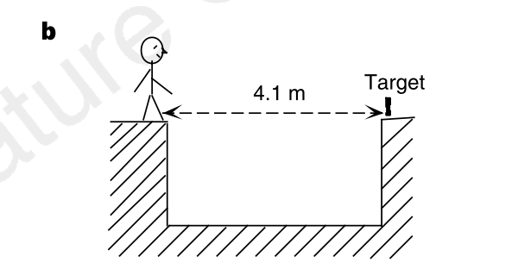
What cues facilitate depth perception in natural environments?
Visible Ground Plane
Texture Gradient
Relative Size
Angular Declination
Familiar Size
Notes:
Familiar size
Take this car for example - we are all experienced enough with cars to know the general size of a car. If the retinal size of the object is different than what you know, this can indicate distance.
If we know how big an object is, then trigonometrically we are able to come to distance
------------------------------------------------------------------------------------------------------------------------------------------------------------------------------------------------------------------------------------------------------------------------
Tan (opp/adj)
Opposite is the linear isze, and adjacent is the distance
Linear size is familiar size, so we can recover the distance
If I know how big it is, angular size, then I can calculate the distance

Slide 5
What cues facilitate depth perception in natural environments?
Visible Ground Plane
Texture Gradient
Relative Size
Angular Declination
Familiar Size
Notes:
Familiar size
Take this car for example - we are all experienced enough with cars to know the general size of a car. If the retinal size of the object is different than what you know, this can indicate distance.
If we know how big an object is, then trigonometrically we are able to come to distance
------------------------------------------------------------------------------------------------------------------------------------------------------------------------------------------------------------------------------------------------------------------------
Tan (opp/adj)
Opposite is the linear isze, and adjacent is the distance
Linear size is familiar size, so we can recover the distance
If I know how big it is, angular size, then I can calculate the distance

Slide 6
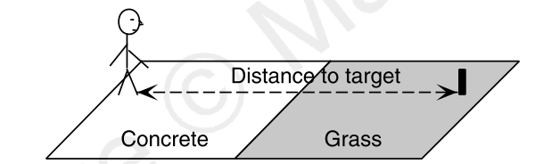
What cues facilitate depth perception in natural environments?
Visible Ground Plane
Texture Gradient
Relative Size
Notes:
Familiar size
Take this car for example - we are all experienced enough with cars to know the general size of a car. If the retinal size of the object is different than what you know, this can indicate distance.
If we know how big an object is, then trigonometrically we are able to come to distance
------------------------------------------------------------------------------------------------------------------------------------------------------------------------------------------------------------------------------------------------------------------------
Tan (opp/adj)
Opposite is the linear isze, and adjacent is the distance
Linear size is familiar size, so we can recover the distance
If I know how big it is, angular size, then I can calculate the distance

Slide 7
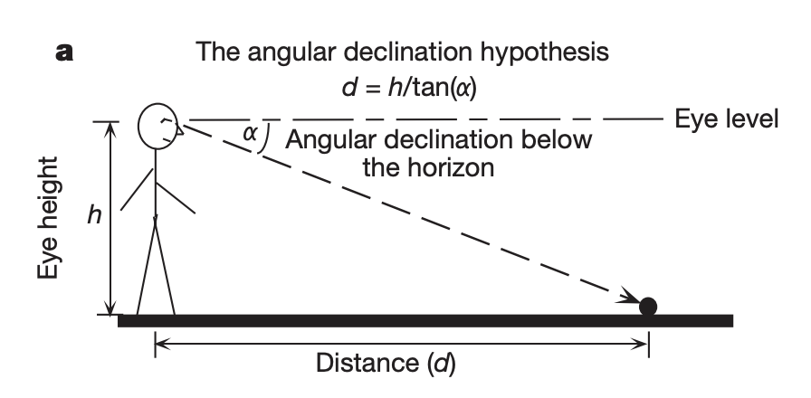
What cues facilitate depth perception in natural environments?
Visible Ground Plane
Texture Gradient
Relative Size
Angular Declination
Notes:
Familiar size
Take this car for example - we are all experienced enough with cars to know the general size of a car. If the retinal size of the object is different than what you know, this can indicate distance.
If we know how big an object is, then trigonometrically we are able to come to distance
------------------------------------------------------------------------------------------------------------------------------------------------------------------------------------------------------------------------------------------------------------------------
Tan (opp/adj)
Opposite is the linear isze, and adjacent is the distance
Linear size is familiar size, so we can recover the distance
If I know how big it is, angular size, then I can calculate the distance

Slide 8
What cues facilitate depth perception in natural environments?
Visible Ground Plane
Texture Gradient
Relative Size
Angular Declination
Familiar Size
Notes:
All these studies that identified these cues as facilitating depth perception, were conducted in the raerl world. But what happens when we only have pictorial cues available? When we view a 2D image, oculomotor cues return flatness, which changes the weighting of cues when comparing the real world to pictures.

Slide 9
What cues facilitate depth perception in natural environments?
Visible Ground Plane
Texture Gradient
Relative Size
Angular Declination
Familiar Size
Notes:
All these studies that identified these cues as facilitating depth perception, were conducted in the raerl world. But what happens when we only have pictorial cues available? When we view a 2D image, oculomotor cues return flatness, which changes the weighting of cues when comparing the real world to pictures.

Slide 10
What is the relative utility of image features in pictured scenes that facilitate depth perception?
What cues facilitate depth perception in natural environments?
Visible Ground Plane
Texture Gradient
Relative Size
Angular Declination
Familiar Size
Notes:
All these studies that identified these cues as facilitating depth perception, were conducted in the raerl world. But what happens when we only have pictorial cues available? When we view a 2D image, oculomotor cues return flatness, which changes the weighting of cues when comparing the real world to pictures.

Slide 11

Spatial Information Processing in Pictured Scenes
Can people reliably judge distance in pictured scenes?
Does individual behavior for unique images generalize across tasks?
What is the relative utility of depth cues in pictured scenes?
Experimental Paradigms
Results
Verbal Judgment
Verbal Judgment
Discrimination
Discrimination
Notes:
There is a lot of heterogeneity in scenes - this means that it is unlikely that one cue is dominant across all scenes. Not to mention the differences in timing for each cue Cues are mutually constrained, and in pictures there is the added challenge of not having oculomotor cues. In pictures oculomotor cues return flatness, but we still get a sense of depth from pictures.
Pictorial cues are informative, we just don’t know the weighting and timing. That is our aim 3.
We know that extended viewing enables a depth representation that is more elaborate. In fact it could provide structure for integrating incoming information or guide attention more efficiently to informative parts of the scene.
Not all scenes have the same amount of cues, and some cues will be accessible later – so we need to be able to adapt.
I’ll discuss how we can capitalize on the complexity and diversity of these real world scenes to answer (1) how verbal estimates change over viewing durations and (2) how the relative weighting of depth cues changes over time

Slide 12
Spatial Information Processing in Pictured Scenes
Can people reliably judge distance in pictured scenes?
Does individual behavior for unique images generalize across tasks?
What is the relative utility of depth cues in pictured scenes?
Experimental Paradigms
Results
Verbal Judgment
Verbal Judgment
Comparative Results
Discrimination
Discrimination
Notes:
There is a lot of heterogeneity in scenes - this means that it is unlikely that one cue is dominant across all scenes. Not to mention the differences in timing for each cue Cues are mutually constrained, and in pictures there is the added challenge of not having oculomotor cues. In pictures oculomotor cues return flatness, but we still get a sense of depth from pictures.
Pictorial cues are informative, we just don’t know the weighting and timing. That is our aim 3.
We know that extended viewing enables a depth representation that is more elaborate. In fact it could provide structure for integrating incoming information or guide attention more efficiently to informative parts of the scene.
Not all scenes have the same amount of cues, and some cues will be accessible later – so we need to be able to adapt.
I’ll discuss how we can capitalize on the complexity and diversity of these real world scenes to answer (1) how verbal estimates change over viewing durations and (2) how the relative weighting of depth cues changes over time

Slide 13
Spatial Information Processing in Pictured Scenes
Can people reliably judge distance in pictured scenes?
Does individual behavior for unique images generalize across tasks?
What is the relative utility of depth cues in pictured scenes?
Experimental Paradigms
Results
Verbal Judgment
Verbal Judgment
Comparative Results
Depth Cue Algorithms
Discrimination
Discrimination
Notes:
There is a lot of heterogeneity in scenes - this means that it is unlikely that one cue is dominant across all scenes. Not to mention the differences in timing for each cue Cues are mutually constrained, and in pictures there is the added challenge of not having oculomotor cues. In pictures oculomotor cues return flatness, but we still get a sense of depth from pictures.
Pictorial cues are informative, we just don’t know the weighting and timing. That is our aim 3.
We know that extended viewing enables a depth representation that is more elaborate. In fact it could provide structure for integrating incoming information or guide attention more efficiently to informative parts of the scene.
Not all scenes have the same amount of cues, and some cues will be accessible later – so we need to be able to adapt.
I’ll discuss how we can capitalize on the complexity and diversity of these real world scenes to answer (1) how verbal estimates change over viewing durations and (2) how the relative weighting of depth cues changes over time

Slide 14
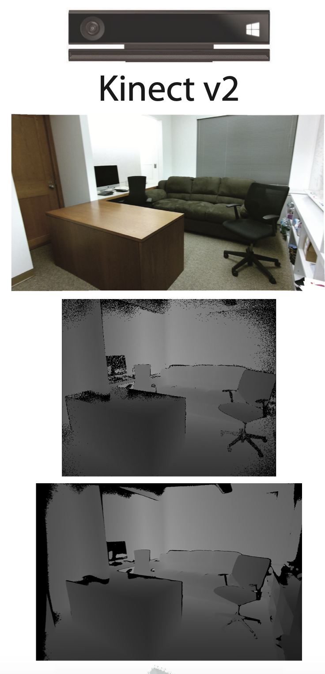
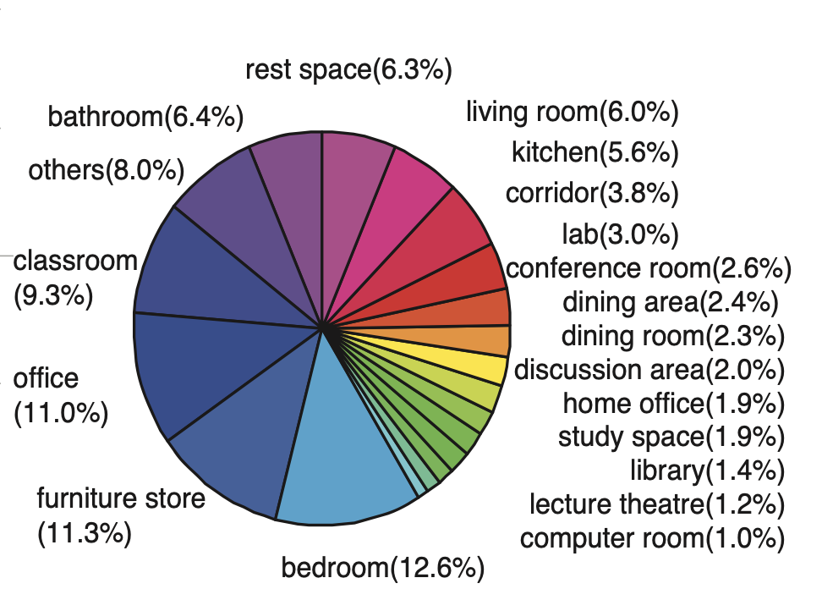
Stimuli: SUN-RGBD Database
Notes:
SUN-RGBD Database
Diverse scenes
Familiar scenes
Ground truth depth
Object segmentation annotations
We are using the SUN-RGBD database to get
Distance judgements in real world scenes
And test depth cue correlations with distance judgements
We did extensive pilot testing to make sure that it is possible to get reliable depth estimates from this database. So for all the endeavors I will detail in the rest of my talk, all the stimuli are from this great database.
All 10,355 images in this dataset were taken with RGB-D sensors that obtain 3D metrics as well as detailed annotations (2D & 3D) for the objects and rooms. Optimal depth map quality was accomplished by taking short videos as well as multiple frames to build the depth map. Each image in the dataset has all 2D polygons segmented and annotated by object, 3D bounding boxes, and 3D polygons for room layout.
These images are robust in scene diversity and have ground-truth depth tagged making them ideal for an investigation of depth cues in natural scenes.

Slide 15

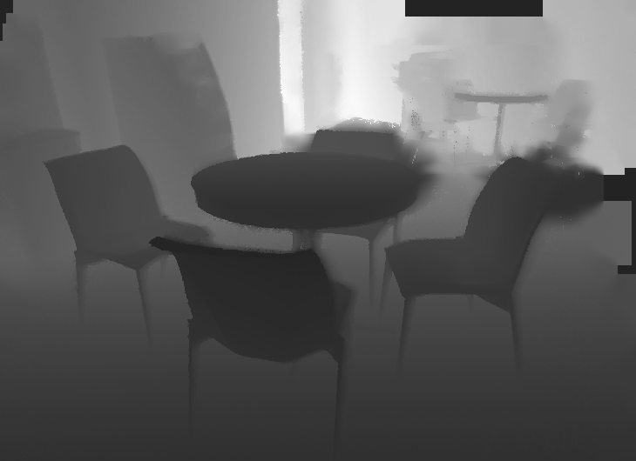

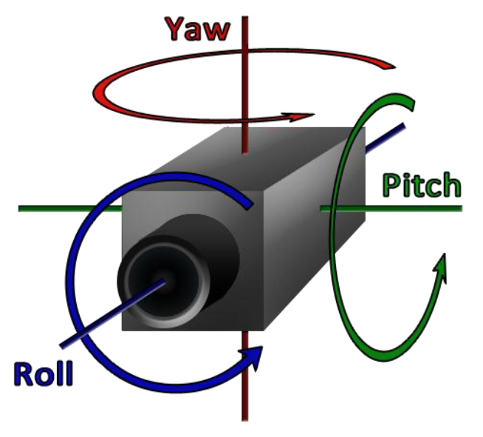
Stimulus Selection
Target Placement
Image Selection Criterion
Semantic clarity
Camera rotation
Decent object segmentation
Kinectv2 Depth Map
530 x 730 matrix
Notes:
/Users/prachimahableshwarkar/Documents/GW/2019-2020/code/SUNRGBD/kv2/kinect2data/000080_2014-05-14_21-36-38_260595134347_rgbf000132-resize

Slide 16
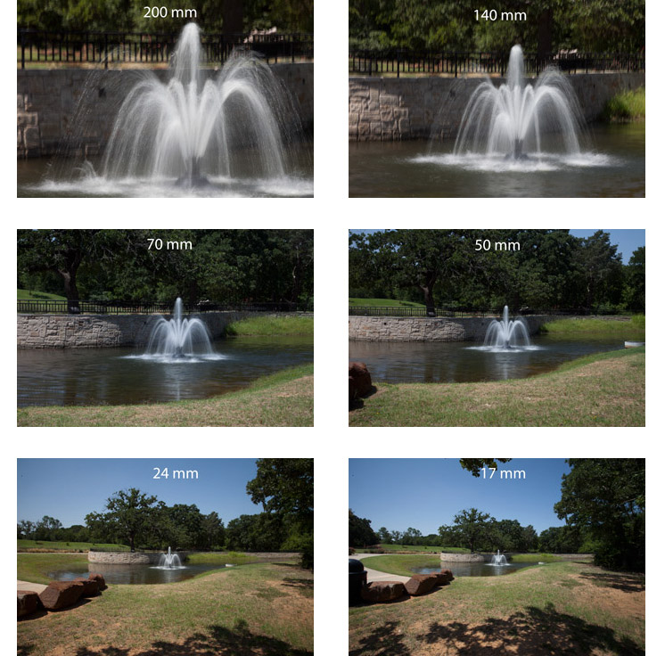
Focal Length
Focal length determines how much of a scene is captured in an image.
Shorter focal length = wider field of view
Long focal lengths = smaller field of view.
Notes:
Since we are looking at pictured scenes, its incredibly important to consider camera parameters like focal length.
Focal length determines how much of a scene is captured in an image. The difference in field of view can drastically alter depth judgements. Consider the two images on the bottom - you are likely to get drastically different judgements of depth to that water fountain because of the field of view and perspective.
For this reason – ACCURACY is not a good metric when considering performance. Instead sensitivity to depth and bias are more indicative of ability.
All SUN-RGBD images had the same focal length, so there was no concern that this image feature would interact with performance.
___________________________________________________________________________________________________________________________________________________________________________________________
Cues are not exactly thhe same between real world and picture
http://www.outdoorphotoacademy.com/focal-lengths/
SUN-RGBD all had same focal length
Lead into why ACCURACY is not as interesting as sensitivity and bias
Field of view. Focal length determines how much of a scene is captured in an image. Shorter focal length lenses are called wide-angle lenses because they allow you to get a wider field of view in one image. Lenses with long focal lengths are called telephoto lenses, and have a smaller field of view.
Depth of field. Lenses with long focal lengths tend to have a shallow depth of field, which means they can focus in on small objects (even faraway ones) at specific distances. Meanwhile, lenses with short focal lengths have a larger depth of field, which enables them to get a wider range of elements in focus.
Perspective. Focal length can also change the perspective and scale of your images. A lens with a shorter focal length “expands” perspective, giving the appearance of more space between the elements in your photo. Meanwhile, telephoto lenses tend to stack elements in the frame together to “compress” perspective.

Slide 17
Spatial Information Processing in Pictured Scenes
Can people reliably judge distance in pictured scenes?
Does individual behavior for unique images generalize across tasks?
What is the relative utility of depth cues in pictured scenes?
Experimental Paradigms
Results
Verbal Judgment
Verbal Judgment
Comparative Results
Depth Cue Algorithms
Discrimination
Discrimination
Notes:
There is a lot of heterogeneity in scenes - this means that it is unlikely that one cue is dominant across all scenes. Not to mention the differences in timing for each cue Cues are mutually constrained, and in pictures there is the added challenge of not having oculomotor cues. In pictures oculomotor cues return flatness, but we still get a sense of depth from pictures.
Pictorial cues are informative, we just don’t know the weighting and timing. That is our aim 3.
We know that extended viewing enables a depth representation that is more elaborate. In fact it could provide structure for integrating incoming information or guide attention more efficiently to informative parts of the scene.
Not all scenes have the same amount of cues, and some cues will be accessible later – so we need to be able to adapt.
I’ll discuss how we can capitalize on the complexity and diversity of these real world scenes to answer (1) how verbal estimates change over viewing durations and (2) how the relative weighting of depth cues changes over time

Slide 18
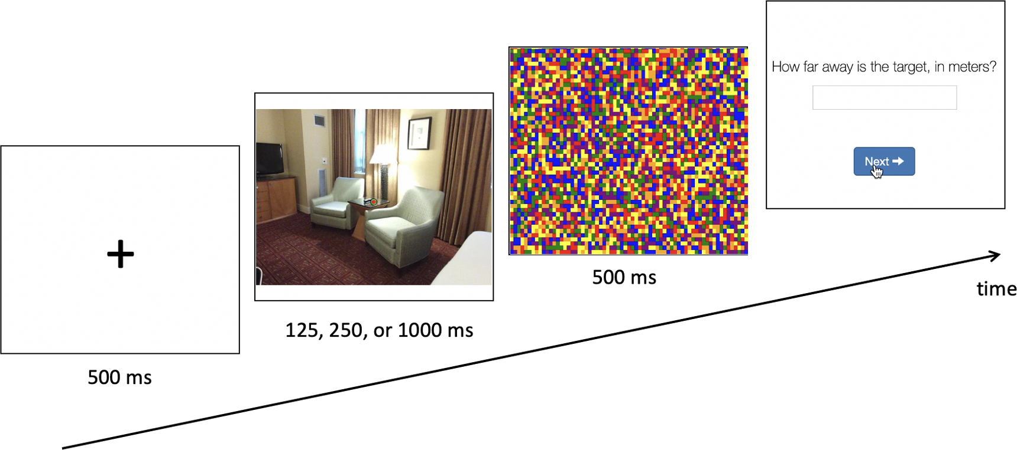

Experimental Paradigms
Verbal Judgment
N = 468
156 trials
Latin square counterbalancing
Explicit estimate

Slide 19
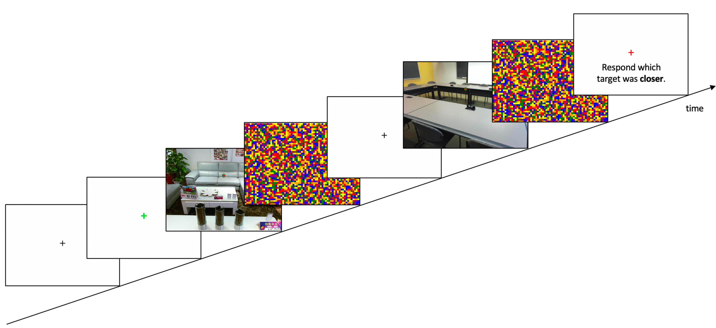
Experimental Paradigms
Verbal Judgment
N = 468
156 trials
Latin square counterbalancing
Explicit estimate
Identical stimulus set
Matched trial orders across task
Independent participants
Discrimination
N = 468
78 trials
Latin square counterbalancing
Keypress (‘z’ or ‘m’)

Slide 20
Experimental Paradigms
Verbal Judgment
N = 468
156 trials
Latin square counterbalancing
Explicit estimate
Shared
Identical stimulus set
Matched trial orders across task
Independent participants
Discrimination
N = 468
78 trials
Latin square counterbalancing
Keypress (‘z’ or ‘m’)

Slide 21
Spatial Information Processing in Pictured Scenes
Can people reliably judge distance in pictured scenes?
Does individual behavior for unique images generalize across tasks?
What is the relative utility of depth cues in pictured scenes?
Experimental Paradigms
Results
Verbal Judgment
Verbal Judgment
Comparative Results
Depth Cue Algorithms
Discrimination
Discrimination
Notes:
There is a lot of heterogeneity in scenes - this means that it is unlikely that one cue is dominant across all scenes. Not to mention the differences in timing for each cue Cues are mutually constrained, and in pictures there is the added challenge of not having oculomotor cues. In pictures oculomotor cues return flatness, but we still get a sense of depth from pictures.
Pictorial cues are informative, we just don’t know the weighting and timing. That is our aim 3.
We know that extended viewing enables a depth representation that is more elaborate. In fact it could provide structure for integrating incoming information or guide attention more efficiently to informative parts of the scene.
Not all scenes have the same amount of cues, and some cues will be accessible later – so we need to be able to adapt.
I’ll discuss how we can capitalize on the complexity and diversity of these real world scenes to answer (1) how verbal estimates change over viewing durations and (2) how the relative weighting of depth cues changes over time

Slide 22
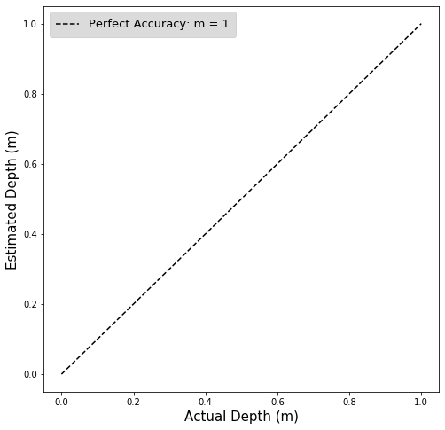
Linear Model of Individual Stimuli
Notes:
So lets get right to the data
For all of the plots I will be explaining today there is this general format
On the x axis we have actual depth
On the y axis we have estimated depth
The dotted line represents what the slope would be if sensitivity was perfect
- Remember we are most interested in sensitivity, aka slope,

Slide 23
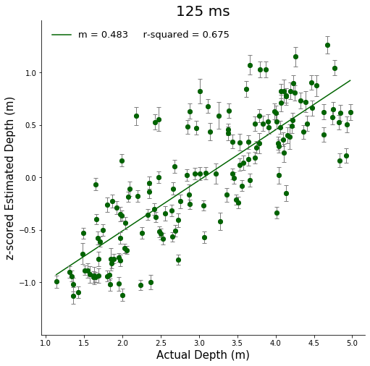
Linear Model of Individual Stimuli

Slide 24
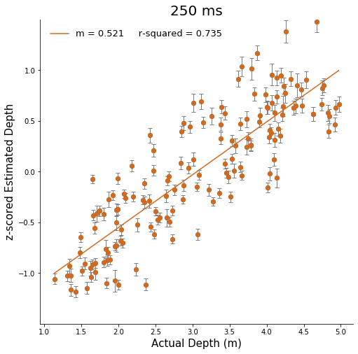
Linear Model of Individual Stimuli

Slide 25
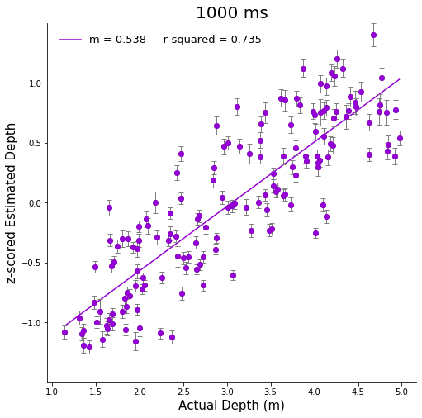
Linear Model of Individual Stimuli

Slide 26
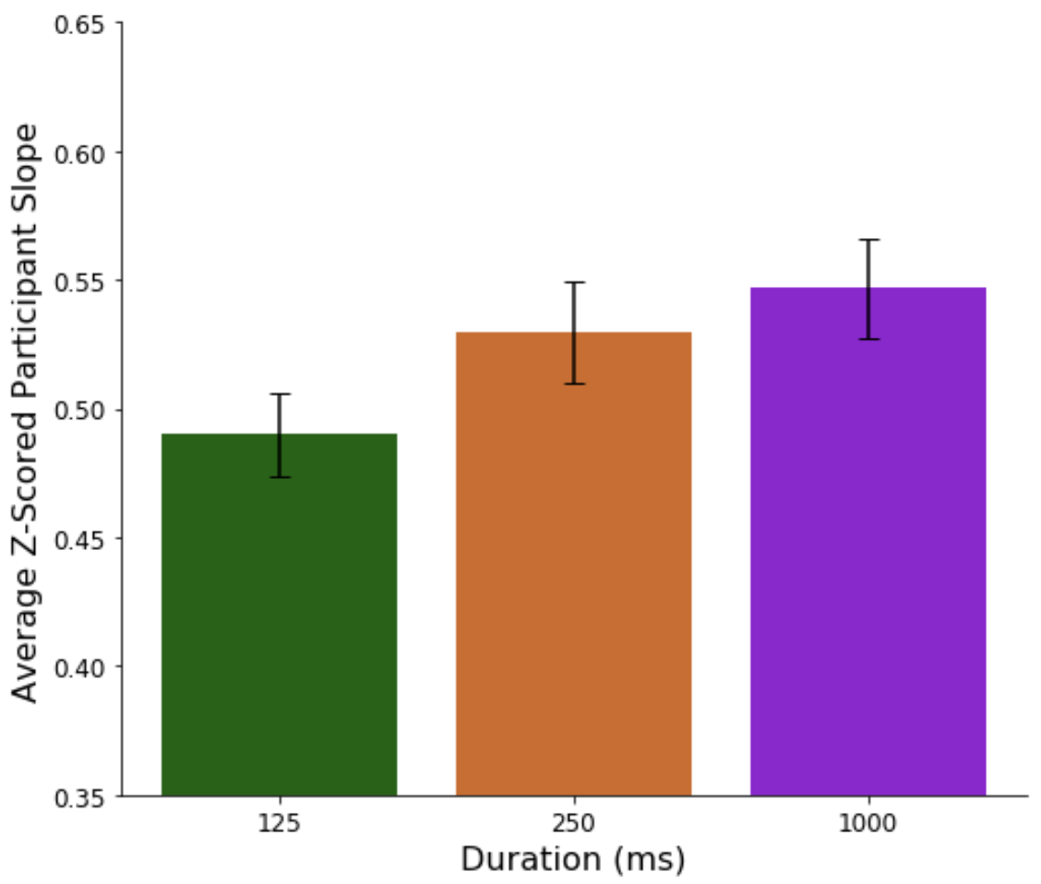
Does sensitivity to distance improve with longer viewing durations?

Slide 27
Spatial Information Processing in Pictured Scenes
Can people reliably judge distance in pictured scenes?
Does individual behavior for unique images generalize across tasks?
What is the relative utility of depth cues in pictured scenes?
Experimental Paradigms
Results
Verbal Judgment
Verbal Judgment
Comparative Results
Depth Cue Algorithms
Discrimination
Discrimination
Notes:
There is a lot of heterogeneity in scenes - this means that it is unlikely that one cue is dominant across all scenes. Not to mention the differences in timing for each cue Cues are mutually constrained, and in pictures there is the added challenge of not having oculomotor cues. In pictures oculomotor cues return flatness, but we still get a sense of depth from pictures.
Pictorial cues are informative, we just don’t know the weighting and timing. That is our aim 3.
We know that extended viewing enables a depth representation that is more elaborate. In fact it could provide structure for integrating incoming information or guide attention more efficiently to informative parts of the scene.
Not all scenes have the same amount of cues, and some cues will be accessible later – so we need to be able to adapt.
I’ll discuss how we can capitalize on the complexity and diversity of these real world scenes to answer (1) how verbal estimates change over viewing durations and (2) how the relative weighting of depth cues changes over time

Slide 28
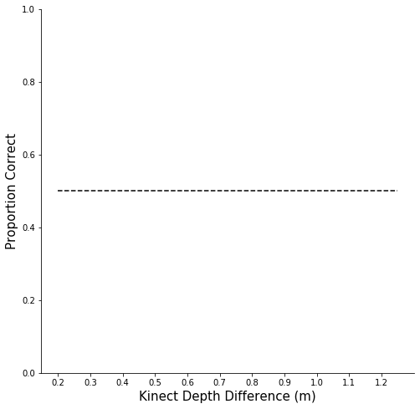
Discrimination Performance: Kinect coded Accuracy
Notes:
On the x axis we have the depth difference, as defined by the Kinect and on the y axis we have proportion correct

Slide 29
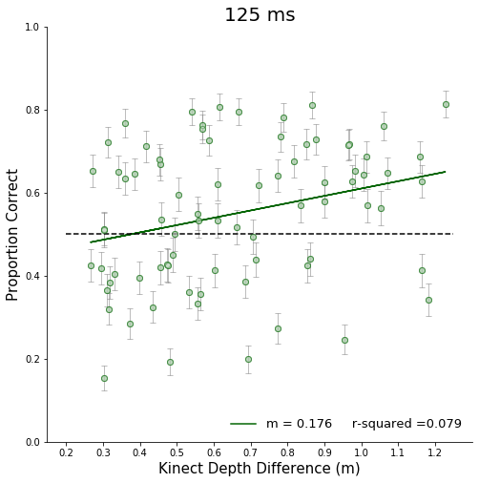
Discrimination Performance: Kinect coded Accuracy
Notes:
This is the data at 1000 ms, and as you can see there are a lot of trials below chance. The slope is relatively low with a low r-squared. Although there is a significant relationship between kienct depth difference and PC, clearly it is not a good regressor.

Slide 30
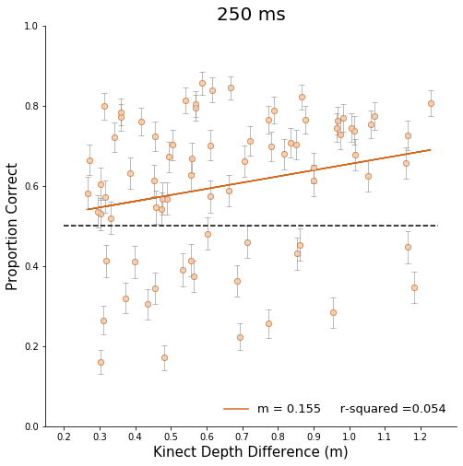
Discrimination Performance: Kinect coded Accuracy
Notes:
This is the data at 1000 ms, and as you can see there are a lot of trials below chance. The slope is relatively low with a low r-squared. Although there is a significant relationship between kienct depth difference and PC, clearly it is not a good regressor.

Slide 31
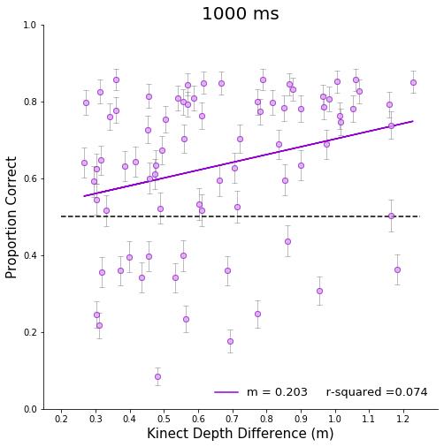
Discrimination Performance: Kinect coded Accuracy
Notes:
As we look at the other durations – we see similar patterns.
Now if we step back and think about a ground truth depth map – at really large depth differences we would expect to see almost ceiling accuracy since the difference should be really stark. Here however we are using smaller indoor scenes.
At this smaller scale, it is possible that experience and expectation related to the semantics of the scene shift our depth map away from the Kinect depth map. For this reason we decided to look at discrimination performance relative to independent verbal estimates of depth in the same stimuli.

Slide 32
Can people reliably judge distance in individual scenes?

Slide 33

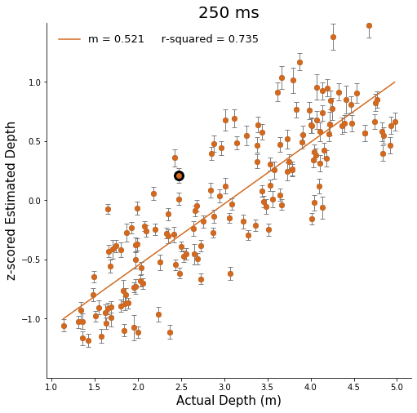
Can people reliably judge distance in individual scenes?

Slide 34
Can people reliably judge distance in individual scenes?

Slide 35
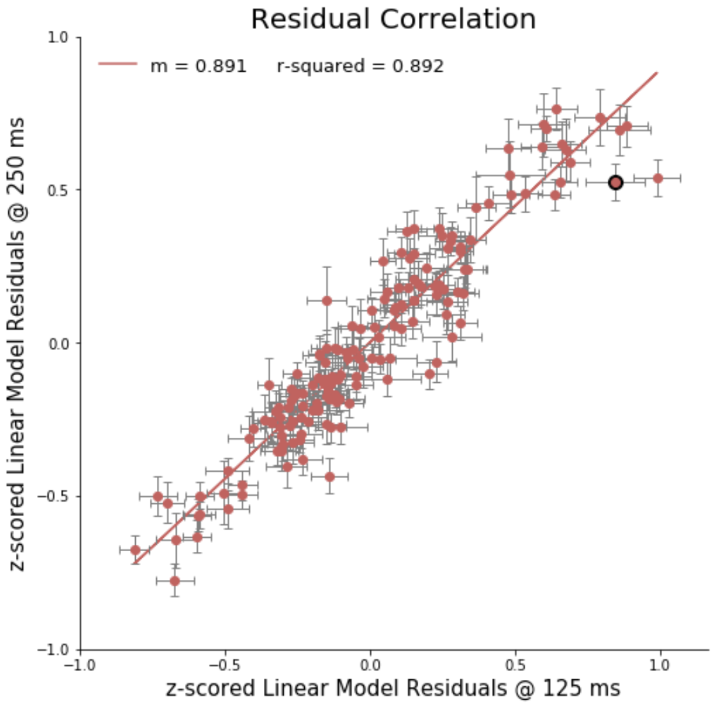
Can people reliably judge distance in individual scenes?
Z-Scored Linear Model Residuals @ 250 ms
Z-Scored Linear Model Residuals @ 125 ms

Slide 36
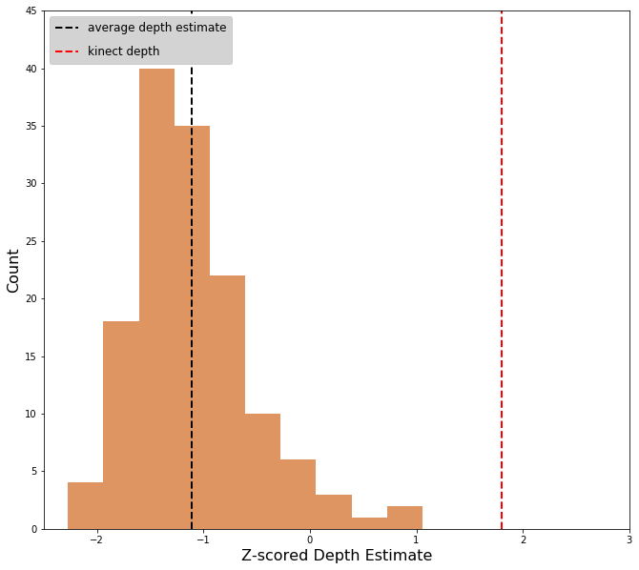
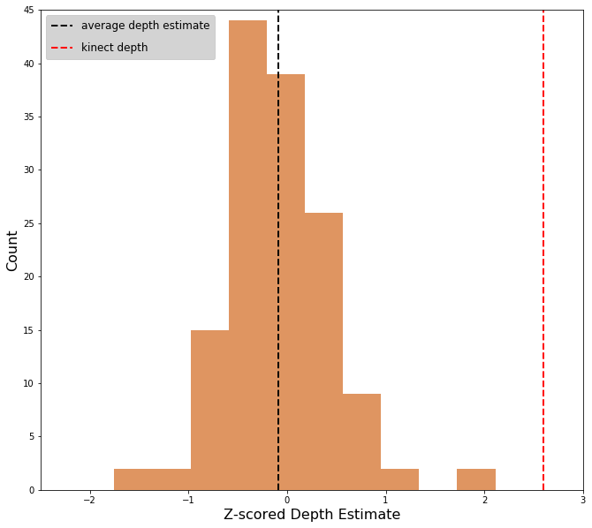
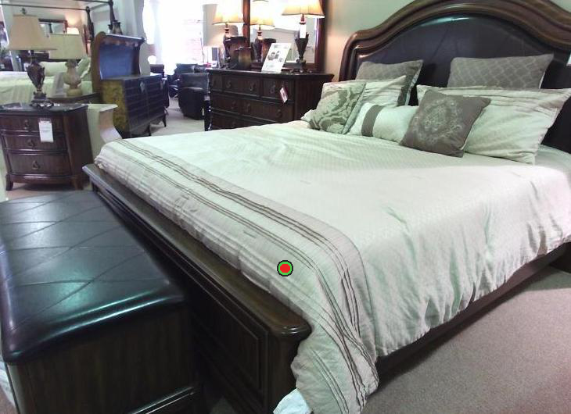
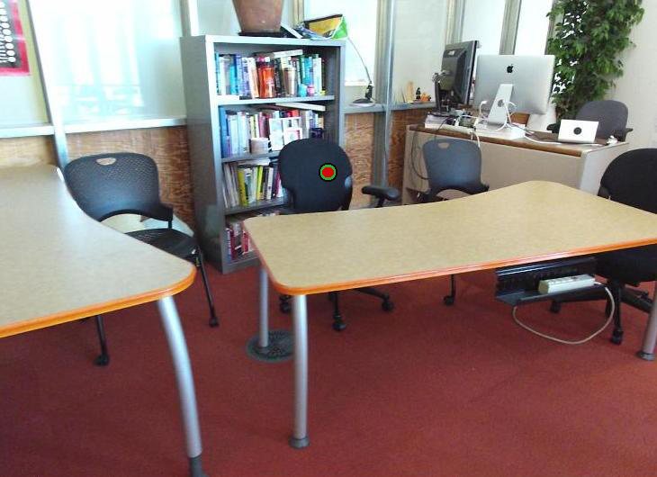
How predictable is discrimination performance from independent verbal judgments (Exp 1)?
VE Stimulus 0
VE Stimulus 1
Which target was closer to you?
Notes:
The question here is – how predictable is discrimination performance from independent verbal judgments?
To step through the process
For each discrimination trial we take a look at the verbal estimates given in experiment 1 (independent groups of people)
On the left here we have a distribution of estimates for stim0 with the average depth estimate labeled in place and the kienct depth in red
Asked the question which target was closer, going off of the VE data the answer is stim 0

Slide 37
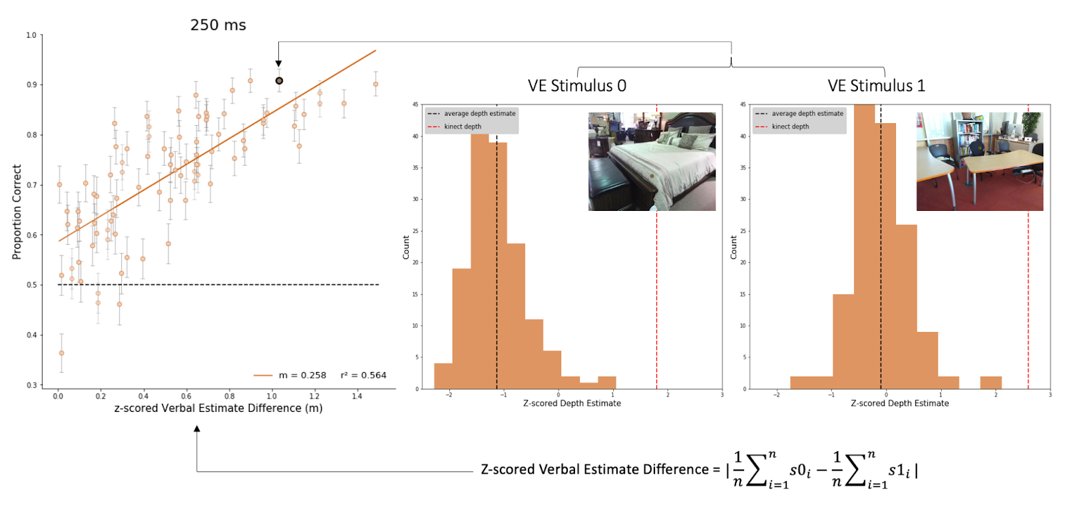
How predictable is discrimination performance from independent verbal judgments (Exp 1)?
Notes:
We do this for every single trial in the discrimination data
Take the abs value of the difference between the average z scored estimates for each image
This ‘answer key’ is then used against the discrimination data to derive percent correct
In this example we can see that at 250 ms, the accuracy is quite high for this trial

Slide 38
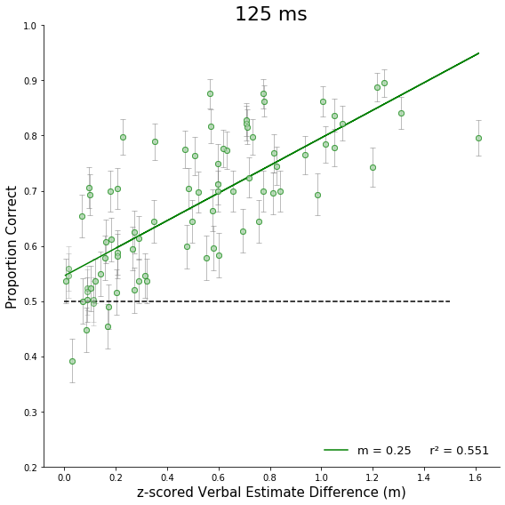
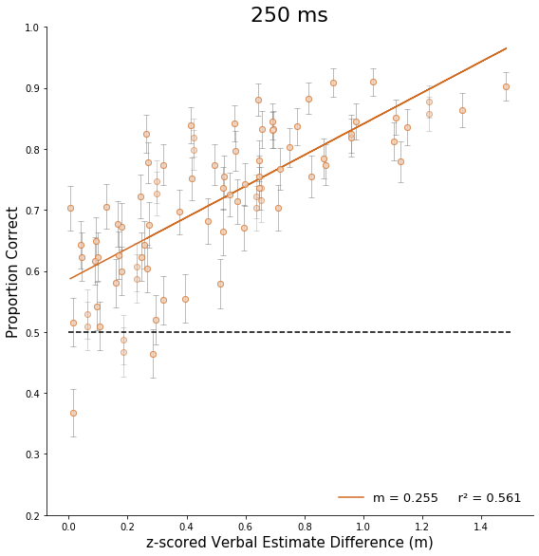
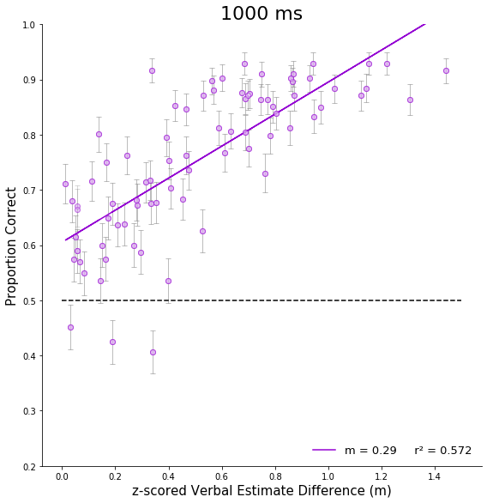
Do independent verbal judgments predict discrimination accuracy?

Slide 39

How does viewing duration impact accuracy?
$$∗∗∗$$

Slide 40
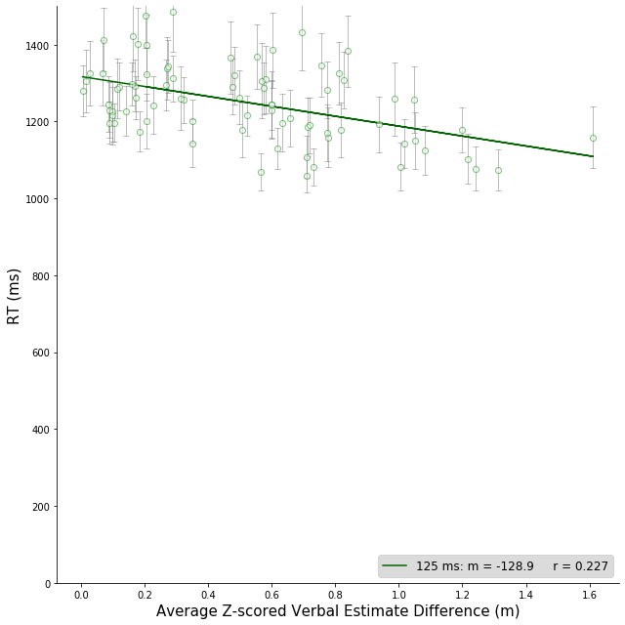
Do independent verbal judgments predict discrimination reaction time?

Slide 41
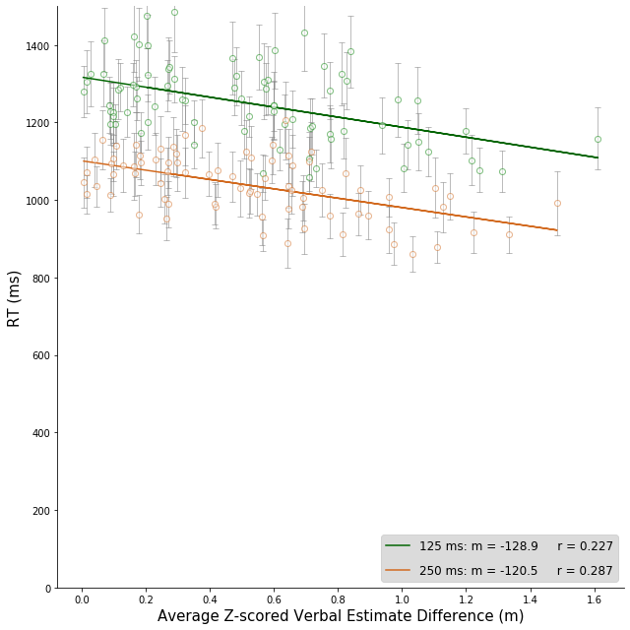
Do independent verbal judgments predict discrimination reaction time?

Slide 42
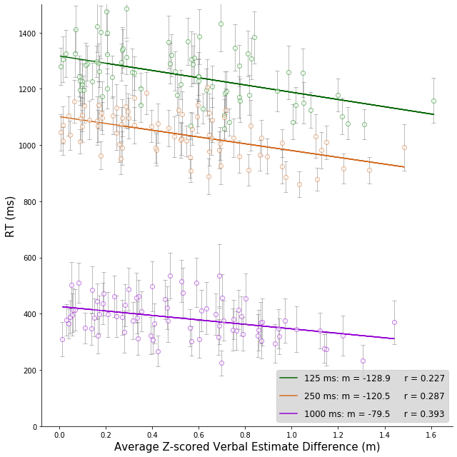



Do independent verbal judgments predict discrimination reaction time?
$$∗∗∗$$
$$∗∗∗$$
$$∗∗∗$$
Note: Pairwise duration independent t-tests
*** Indicates p < 0.001

Slide 43
Spatial Information Processing in Pictured Scenes
Can people reliably judge distance in pictured scenes?
Does individual behavior for unique images generalize across tasks?
What is the relative utility of depth cues in pictured scenes?
Experimental Paradigms
Results
Verbal Judgment
Verbal Judgment
Comparative Results
Depth Cue Algorithms
Discrimination
Discrimination
Notes:
There is a lot of heterogeneity in scenes - this means that it is unlikely that one cue is dominant across all scenes. Not to mention the differences in timing for each cue Cues are mutually constrained, and in pictures there is the added challenge of not having oculomotor cues. In pictures oculomotor cues return flatness, but we still get a sense of depth from pictures.
Pictorial cues are informative, we just don’t know the weighting and timing. That is our aim 3.
We know that extended viewing enables a depth representation that is more elaborate. In fact it could provide structure for integrating incoming information or guide attention more efficiently to informative parts of the scene.
Not all scenes have the same amount of cues, and some cues will be accessible later – so we need to be able to adapt.
I’ll discuss how we can capitalize on the complexity and diversity of these real world scenes to answer (1) how verbal estimates change over viewing durations and (2) how the relative weighting of depth cues changes over time

Slide 44
How generalizable are spatial judgments across task, duration, and outcome?
Verbal Judgment
N = 468
156 trials
Latin square counterbalancing
Explicit estimate
Shared
Identical stimulus set
Matched trial orders across task
Independent participants
Discrimination
N = 468
78 trials
Latin square counterbalancing
Keypress (‘z’ or ‘m’)
Notes:
This relationship between VE and Discrimination in independent groups of people led us to ask – how generalizable are spatial judgments?
Here we have a matrix crossing TASK, DURATION, and OUTCOME so we can assess the relationship between all these conditions. In order to best understand the reliability of this data however we decided to split the data many times in each of these cells.
The data in each cell was randomly split in half many times, and we generated a correlation matrix for each split.
This plot is the average correlation across all those splits.
Here we have recovered the diagonal so we can assess the reliability within a certain cell
Theres a lot of informatin here so lets step through some of the most prominent effects – all cells with a corr above 0.157 are significant

Slide 45
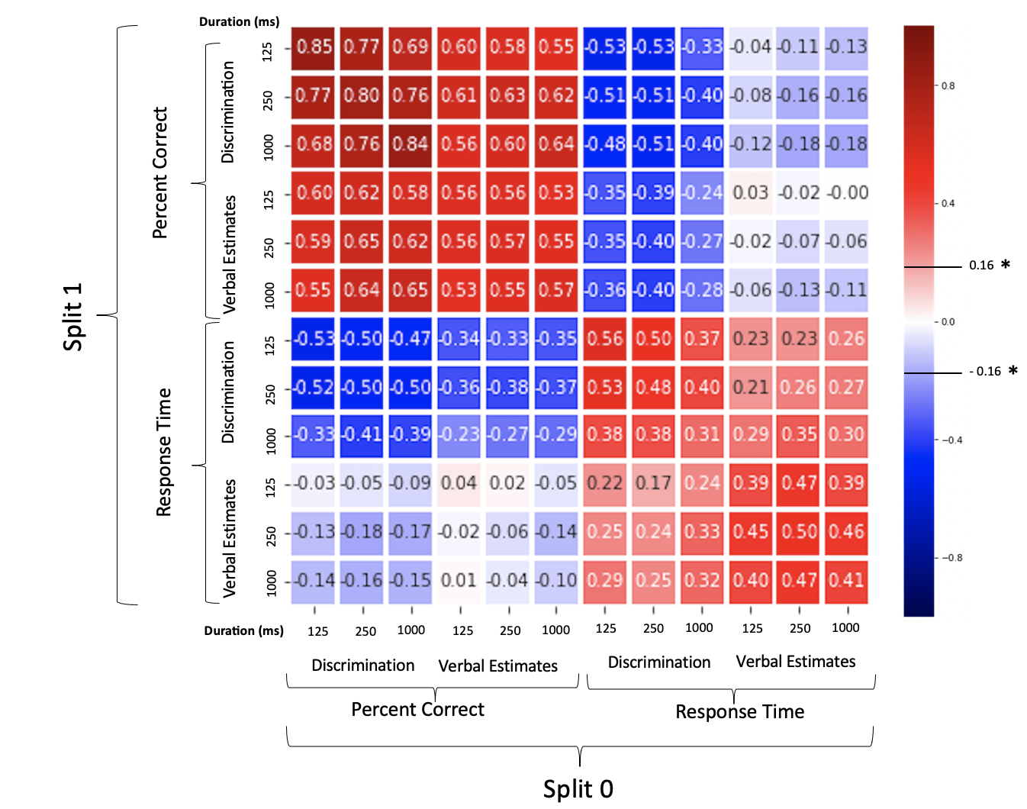
How generalizable are spatial judgments across task, duration, and outcome?
Verbal Judgment
N = 468
156 trials
Latin square counterbalancing
Explicit estimate
Shared
Identical stimulus set
Matched trial orders across task
Independent participants
Discrimination
N = 468
78 trials
Latin square counterbalancing
Keypress (‘z’ or ‘m’)
Notes:
This relationship between VE and Discrimination in independent groups of people led us to ask – how generalizable are spatial judgments?
Here we have a matrix crossing TASK, DURATION, and OUTCOME so we can assess the relationship between all these conditions. In order to best understand the reliability of this data however we decided to split the data many times in each of these cells.
The data in each cell was randomly split in half many times, and we generated a correlation matrix for each split.
This plot is the average correlation across all those splits.
Here we have recovered the diagonal so we can assess the reliability within a certain cell
Theres a lot of informatin here so lets step through some of the most prominent effects – all cells with a corr above 0.157 are significant

Slide 46
How generalizable are spatial judgments across task, duration, and outcome?
Verbal Judgment
N = 468
156 trials
Latin square counterbalancing
Explicit estimate
Shared
Identical stimulus set
Matched trial orders across task
Independent participants
Discrimination
N = 468
78 trials
Latin square counterbalancing
Keypress (‘z’ or ‘m’)
Within task accuracy is highly reliable
Notes:
This relationship between VE and Discrimination in independent groups of people led us to ask – how generalizable are spatial judgments?
Here we have a matrix crossing TASK, DURATION, and OUTCOME so we can assess the relationship between all these conditions. In order to best understand the reliability of this data however we decided to split the data many times in each of these cells.
The data in each cell was randomly split in half many times, and we generated a correlation matrix for each split.
This plot is the average correlation across all those splits.
Here we have recovered the diagonal so we can assess the reliability within a certain cell
Theres a lot of informatin here so lets step through some of the most prominent effects – all cells with a corr above 0.157 are significant

Slide 47
How generalizable are spatial judgments across task, duration, and outcome?
Verbal Judgment
N = 468
156 trials
Latin square counterbalancing
Explicit estimate
Within task accuracy is highly reliable
Shared
Identical stimulus set
Matched trial orders across task
Independent participants
Discrimination
N = 468
78 trials
Latin square counterbalancing
Keypress (‘z’ or ‘m’)
Notes:
Can decode task using accuracy

Slide 48
How generalizable are spatial judgments across task, duration, and outcome?
Verbal Judgment
N = 468
156 trials
Latin square counterbalancing
Explicit estimate
Shared
Identical stimulus set
Matched trial orders across task
Independent participants
Task can be decoded using accuracy correlations
Discrimination
N = 468
78 trials
Latin square counterbalancing
Keypress (‘z’ or ‘m’)
Notes:
Can decode task using accuracy

Slide 49
How generalizable are spatial judgments across task, duration, and outcome?
Verbal Judgment
N = 468
156 trials
Latin square counterbalancing
Explicit estimate
Shared
Identical stimulus set
Matched trial orders across task
Independent participants
Significant between task generalization in accuracy
Discrimination
N = 468
78 trials
Latin square counterbalancing
Keypress (‘z’ or ‘m’)

Slide 50
How generalizable are spatial judgments across task, duration, and outcome?
Verbal Judgment
N = 468
156 trials
Latin square counterbalancing
Explicit estimate
Shared
Identical stimulus set
Matched trial orders across task
Independent participants
Significant between task generalization in accuracy
Systematic errors and biases between tasks
for individual stimuli
Discrimination
N = 468
78 trials
Latin square counterbalancing
Keypress (‘z’ or ‘m’)

Slide 51
How generalizable are spatial judgments across task, duration, and outcome?
Verbal Judgment
N = 468
156 trials
Latin square counterbalancing
Explicit estimate
Shared
Identical stimulus set
Matched trial orders across task
Independent participants
Response time from discrimination reliably predicts verbal judgment accuracy
Discrimination
N = 468
78 trials
Latin square counterbalancing
Keypress (‘z’ or ‘m’)
Notes:
This relationship between VE and Discrimination in independent groups of people led us to ask – how generalizable are spatial judgments?
Here we have a matrix crossing TASK, DURATION, and OUTCOME so we can assess the relationship between all these conditions. In order to best understand the reliability of this data however we decided to split the data many times in each of these cells.
The data in each cell was randomly split in half many times, and we generated a correlation matrix for each split.
This plot is the average correlation across all those splits.
Here we have recovered the diagonal so we can assess the reliability within a certain cell
Theres a lot of informatin here so lets step through some of the most prominent effects – all cells with a corr above 0.157 are significant

Slide 52
How generalizable are spatial judgments across task, duration, and outcome?
Verbal Judgment
N = 468
156 trials
Latin square counterbalancing
Explicit estimate
Shared
Identical stimulus set
Matched trial orders across task
Independent participants
Response time from discrimination reliably predicts verbal judgment accuracy
Stimulus driven generalization between task, duration, and outcome measure
Discrimination
N = 468
78 trials
Latin square counterbalancing
Keypress (‘z’ or ‘m’)
Notes:
This relationship between VE and Discrimination in independent groups of people led us to ask – how generalizable are spatial judgments?
Here we have a matrix crossing TASK, DURATION, and OUTCOME so we can assess the relationship between all these conditions. In order to best understand the reliability of this data however we decided to split the data many times in each of these cells.
The data in each cell was randomly split in half many times, and we generated a correlation matrix for each split.
This plot is the average correlation across all those splits.
Here we have recovered the diagonal so we can assess the reliability within a certain cell
Theres a lot of informatin here so lets step through some of the most prominent effects – all cells with a corr above 0.157 are significant

Slide 53
Spatial Information Processing in Pictured Scenes
Can people reliably judge distance in pictured scenes?
Does individual behavior for unique images generalize across tasks?
What is the relative utility of depth cues in pictured scenes?
Experimental Paradigms
Results
Verbal Judgment
Verbal Judgment
Comparative Results
Depth Cue Algorithms
Discrimination
Discrimination
Notes:
There is a lot of heterogeneity in scenes - this means that it is unlikely that one cue is dominant across all scenes. Not to mention the differences in timing for each cue Cues are mutually constrained, and in pictures there is the added challenge of not having oculomotor cues. In pictures oculomotor cues return flatness, but we still get a sense of depth from pictures.
Pictorial cues are informative, we just don’t know the weighting and timing. That is our aim 3.
We know that extended viewing enables a depth representation that is more elaborate. In fact it could provide structure for integrating incoming information or guide attention more efficiently to informative parts of the scene.
Not all scenes have the same amount of cues, and some cues will be accessible later – so we need to be able to adapt.
I’ll discuss how we can capitalize on the complexity and diversity of these real world scenes to answer (1) how verbal estimates change over viewing durations and (2) how the relative weighting of depth cues changes over time

Slide 54
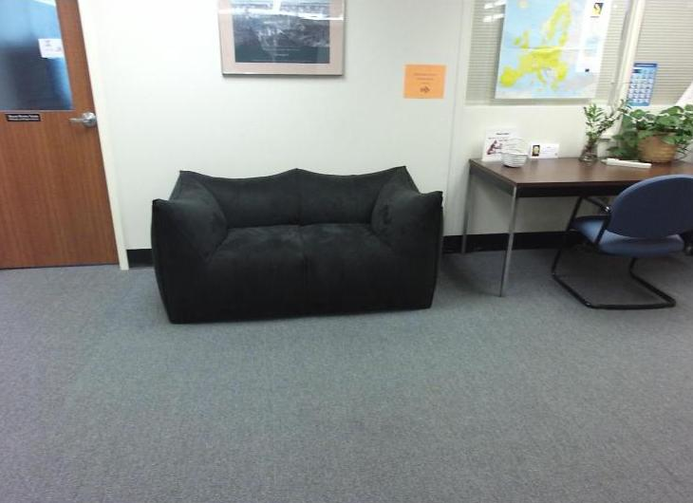
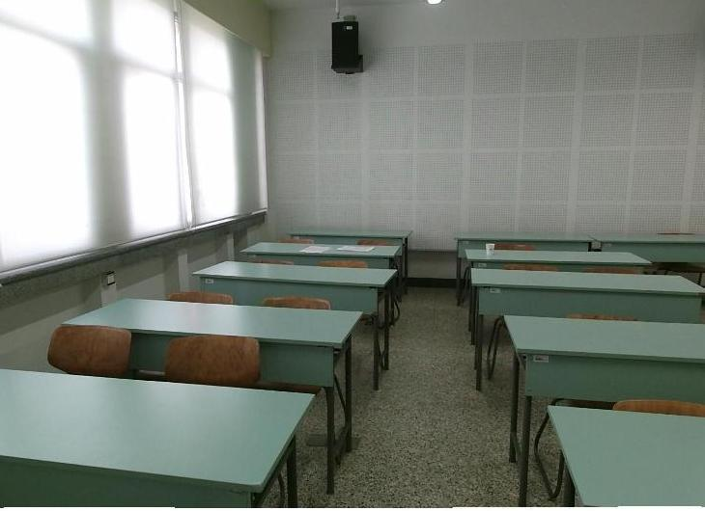
Relative Depth Cues
Visible Ground Plane
Texture Gradient
Relative Size
Angular Declination
Familiar Size
Notes:
Now going back to the cues, I introduced at the beginning of my talk – we can use the depth estimate data to understand the time course of these cues by tracking how individual image performance changes as viewing duration increase.
To do this we need to calculate these cue values in a systematic way.

Slide 55
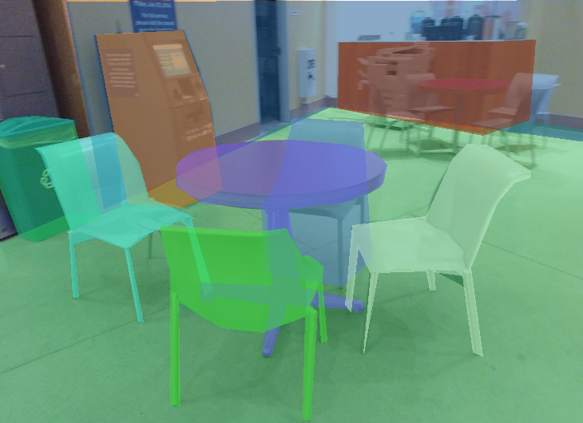
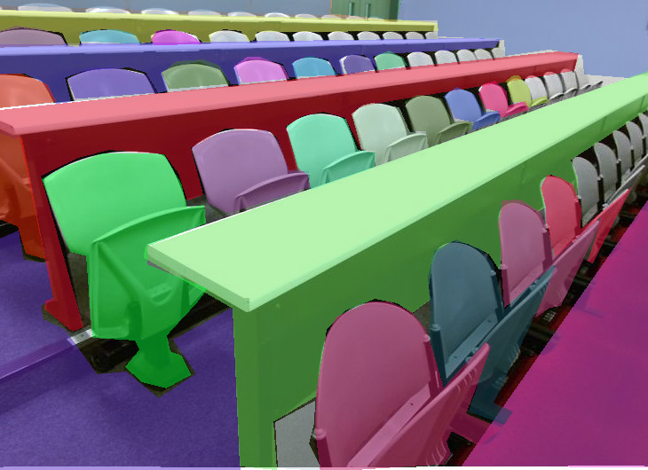

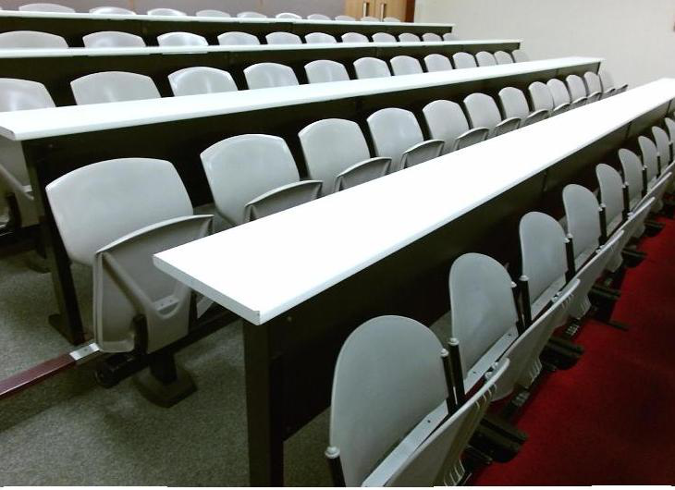
Kinect v2 Object Segmentation
Notes:
Vertices of each object so that each object can be parcellated out
Objects are also labeled

Slide 56
Kinect v2 Object Segmentation
Depth Cue Coding: Relative Size, Visible Ground Plane, Clutter, Familiar Size
Notes:
Visualized object segmentation
Quantify each of these cues
For familiar size, we can create a database of canonical size for certain scene categories:
i.e. general size of bed
Right now this database does not exist and could be helpful in the future

Slide 57
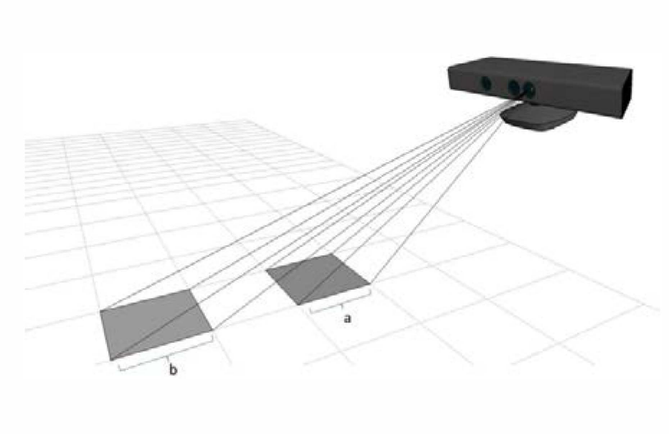
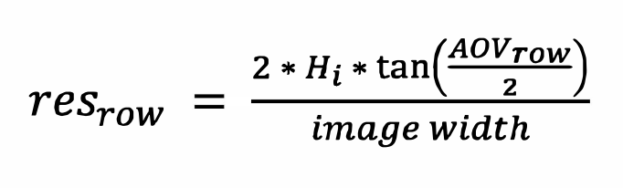
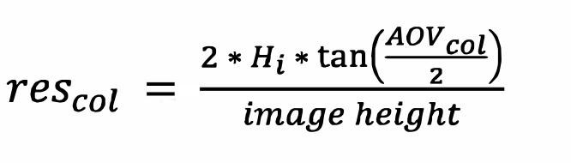
Calculating Real World Object Dimensions
Dynamic Resolution Matrices
(PDF) Calculating real world object dimensions from Kinect RGB-D image using dynamic resolution.
Notes:
﻿- Linear Perspective → the area of the scene captured in a pixel is proportional to the distance of the object from the camera.
So, the pixels closer to the camera will capture a smaller real world area 'a' as compared to the pixels representing objects further away capturing larger area ‘b’
This phenomenon of varying number of pixels per distance "Dynamic Resolution".
AOV = angle of view
Hi = distance from the camera to the object
Image resolution – width, height
Calculates real world width and height

Slide 58
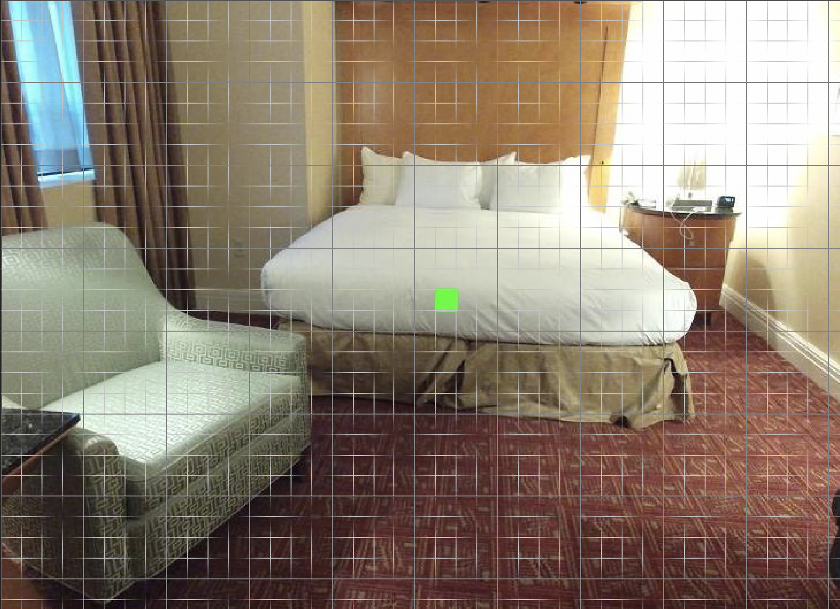
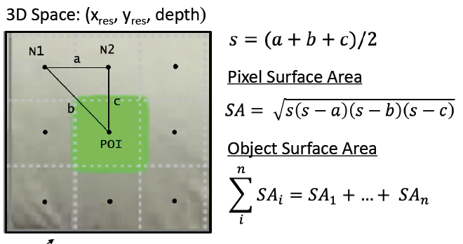
Surface Area

Slide 59
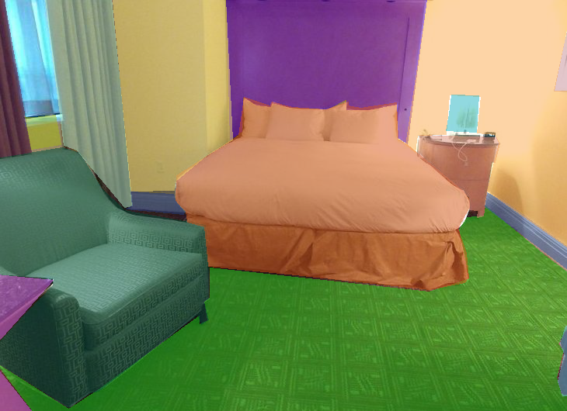
Surface Area
4.41 m²
2.64 m²
9.82 m²
1.76 m²
4.58 m²
7.95 m²

Slide 60
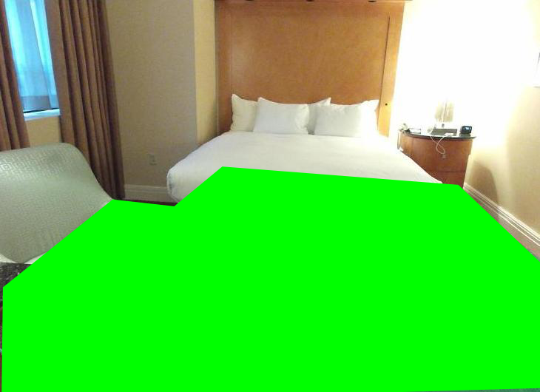
Ground Plane
Visible Ground Plane
Inferred Complete Ground Plane
Notes:
Label the two images
Red polygon visible ground plane
Justify why we need to look at visible and inferred ground plane
Each could contribute an individual signal
Angular declination adjusted by the height of the surface(object) above the ground plane
Role of surfaces (Gibson)

Slide 61
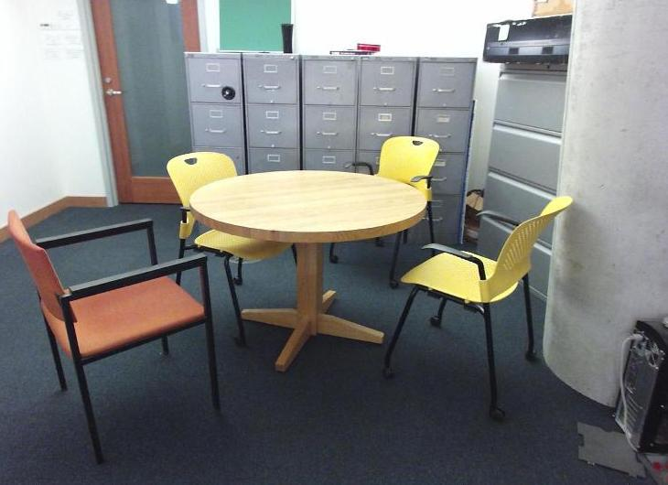
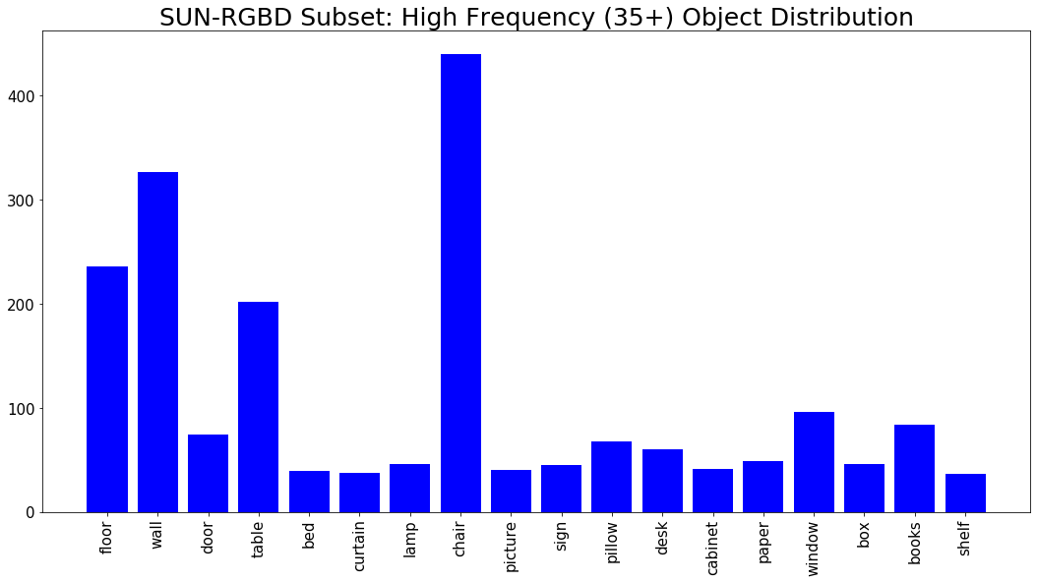
Familiar Size
Notes:
Dictionary of canonical size
Relative size – within image
Familiar size – between images
Objects tend to have a canonical size
We are working to create a database of size
Use size of objects to calibrate spatial layout of the environment

Slide 62
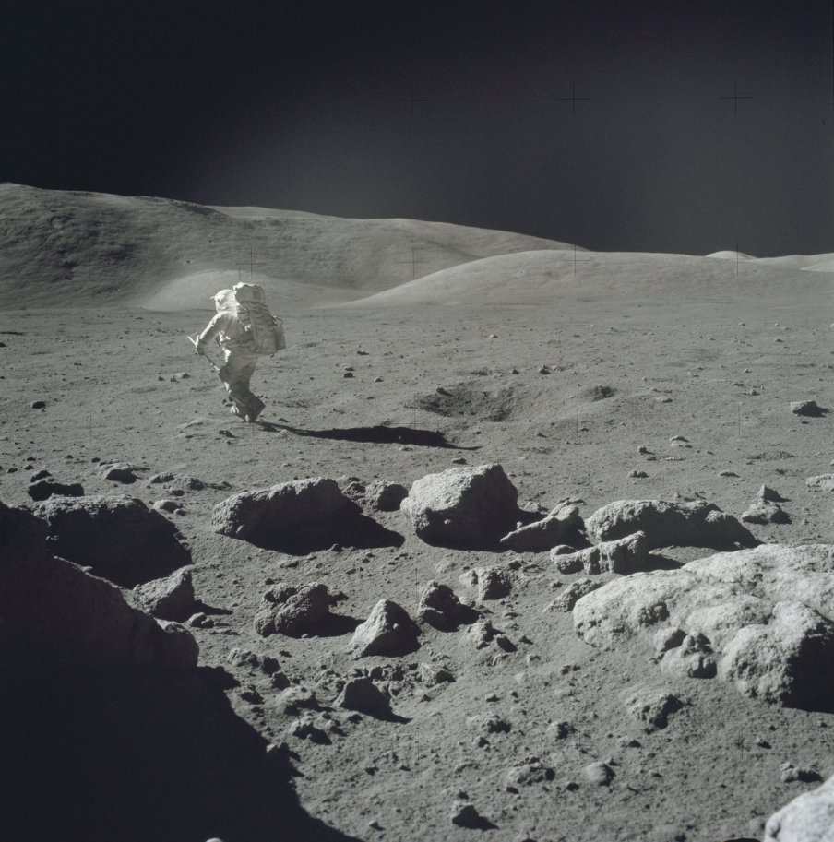
How far away is the hill behind the astronaut?
Notes:
To further emphasize the importance of these cues, consider this question – how far away is the hill behind the astronaut?
There are a lot of factors working against you when I pose this question
This is a picture so oculomotor cues are returning flatness, they are essentially uninformative
So you are forced to rely only on pictorial cues – unfortunately there is very little familiar size information, making it very hard to estimate depth
Hill on background is miles away, but its very hard to tell that given the information you have from pictorial cues.
All this to say – the errors or biases we may have when we encounter scenes are at the crux of our understanding of human depth perception. This is why quantifying the information in a given scene is very important. Particularly in pictures of real world scenes that we navigate in and interact with on a day to day basis.

Slide 63
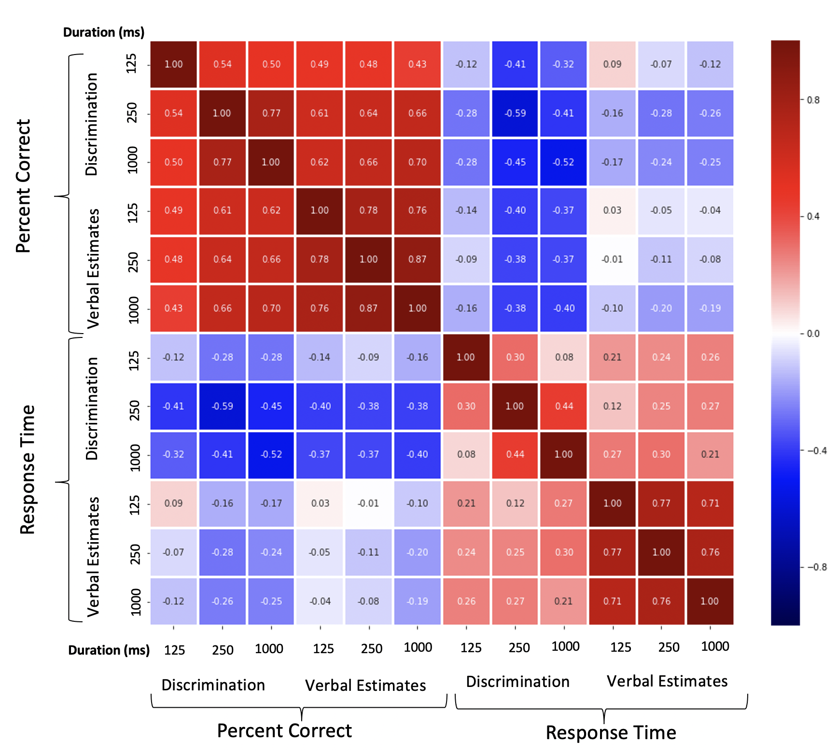
Spatial perception in pictures is precise and systematically biased by features in pictured scenes
Behavioral Data
Verbal Judgment
Comparative Results
Discrimination
Notes:
Depth perception is linked to our Ability to localize objects in the environment → navigation, reaching, throwing, grasping
Requires reliable and stable percept of depth
Basic science: important to understand the information processing behind depth perception
Applications:
Training (VR, military)
Clinical and applied settings – occupations where people have to interface with data to make rapid depth judgements
HCI
Understanding the depth perception mechanism can enable us to optimize trainings as well as human interfaces for accurate depth judgements
In the real world, we do not always get a long glimpse of our environment. We encounter fast moving situations that require a speeded perception of time.
Speed of processing can also decline with age, or neurological problems.
For these reasons knowing how people generally process spatial information over time is of interest.
Interaction and abundance of cues has prevented systematic efforts to understand depth judgements in real world scenes
In the real world we dont always get a long glimpse, fast moving situations, or aging affects that affect speed of processing Knowing about ow people can process spatial info over time is of use bc sometimes we only get brief glimpse Some cues prob come immediately Others take longer to come in Timecourse of individual cues
ERRORS CAN BE MADE WHEN YOU DON’T HAVE A LOT OF TIME – SO WE WANT TO QUANITYF, UNDERSTAND AND PREDICT THOSE ERRORS – FAST MOVING ISTUATION LIKE TRAFFIC OR BE MULTITASKING, HIGH COGNITIVE LOAD, NEURLOGICAL DISORDERS, AGE ETC.

Slide 64

Spatial perception in pictures is precise and systematically biased by features in pictured scenes
Quantification of Pictorial Cues
Behavioral Data
+
Image N = [ground plane, relative size, clutter, …]
Verbal Judgment
Comparative Results
Depth Cue Algorithms
Discrimination
Notes:
Depth perception is linked to our Ability to localize objects in the environment → navigation, reaching, throwing, grasping
Requires reliable and stable percept of depth
Basic science: important to understand the information processing behind depth perception
Applications:
Training (VR, military)
Clinical and applied settings – occupations where people have to interface with data to make rapid depth judgements
HCI
Understanding the depth perception mechanism can enable us to optimize trainings as well as human interfaces for accurate depth judgements
In the real world, we do not always get a long glimpse of our environment. We encounter fast moving situations that require a speeded perception of time.
Speed of processing can also decline with age, or neurological problems.
For these reasons knowing how people generally process spatial information over time is of interest.
Interaction and abundance of cues has prevented systematic efforts to understand depth judgements in real world scenes
In the real world we dont always get a long glimpse, fast moving situations, or aging affects that affect speed of processing Knowing about ow people can process spatial info over time is of use bc sometimes we only get brief glimpse Some cues prob come immediately Others take longer to come in Timecourse of individual cues
ERRORS CAN BE MADE WHEN YOU DON’T HAVE A LOT OF TIME – SO WE WANT TO QUANITYF, UNDERSTAND AND PREDICT THOSE ERRORS – FAST MOVING ISTUATION LIKE TRAFFIC OR BE MULTITASKING, HIGH COGNITIVE LOAD, NEURLOGICAL DISORDERS, AGE ETC.

Slide 65
Spatial perception in pictures is precise and systematically biased by features in pictured scenes
Quantification of Pictorial Cues
Behavioral Data
+
=
Generalizable Model of Spatial Information Understanding in Pictured Scenes
Image N = [ground plane, relative size, clutter, …]
Verbal Judgment
Comparative Results
Depth Cue Algorithms
Discrimination
Notes:
We have computer models that are able to generate accurate depth maps – but it would be amazing if we could develop a model that represents human spatial perception, including our biases so that we can predict error
Depth perception is linked to our Ability to localize objects in the environment → navigation, reaching, throwing, grasping
Requires reliable and stable percept of depth
Basic science: important to understand the information processing behind depth perception
Applications:
Training (VR, military)
Clinical and applied settings – occupations where people have to interface with data to make rapid depth judgements
HCI
Understanding the depth perception mechanism can enable us to optimize trainings as well as human interfaces for accurate depth judgements
In the real world, we do not always get a long glimpse of our environment. We encounter fast moving situations that require a speeded perception of time.
Speed of processing can also decline with age, or neurological problems.
For these reasons knowing how people generally process spatial information over time is of interest.
Interaction and abundance of cues has prevented systematic efforts to understand depth judgements in real world scenes
In the real world we dont always get a long glimpse, fast moving situations, or aging affects that affect speed of processing Knowing about ow people can process spatial info over time is of use bc sometimes we only get brief glimpse Some cues prob come immediately Others take longer to come in Timecourse of individual cues
ERRORS CAN BE MADE WHEN YOU DON’T HAVE A LOT OF TIME – SO WE WANT TO QUANITYF, UNDERSTAND AND PREDICT THOSE ERRORS – FAST MOVING ISTUATION LIKE TRAFFIC OR BE MULTITASKING, HIGH COGNITIVE LOAD, NEURLOGICAL DISORDERS, AGE ETC.

Slide 66
Thank you!

Slide 67
Notes
When results are introduced → have a the experimental paradigm in the corner or at least the question
‘how far is the target’
Respond estimate of distance

Slide 68

Label the point

Slide 69
Archive

Slide 70

Time course of angular declination
How does sensitivity to distance change with increasing duration when angular declination is noninformative ?
Gajewski, Philbeck, Pothier & Chichka (2010)
Notes:
As I mentioned previously, often times we only get a fleeting glimpse of our environment - so the next step is to quantify the speed of extraction for these cues.
Particularly, the question is what cues are available at short durations?
This study investigated what happens when angular declination is rendered non-informative by suspending ball targets at eye level.
Participants completed a blind walking task to a target, and it was found that at short durations performance suffered when angular declination was not available. However with longer viewing durations sensitivity was able to bounce back. This is presumably because other cues became available and could support depth perception.

